Slide 1
ABQ Ride SunVan
Compliance Review Briefing
David Rishel
Delta Services Group, Inc.

Slide 2
Agenda
Introduction
Scope of Review
Findings By Section
Discussion

Slide 3
Delta Services Group
David Rishel
  Founding Director NJ Transit ADA Unit
    Access Link ADA Paratransit
  Mayflower Contract Services
  Consultant
    Court Appointed ADA Auditor, Detroit
    Principal consultant in MBTA ADA Settlement
    Assisting WMATA in major restructuring
    Assisted RTA Chicago with paratransit consolidation
    Analyzed ASI LA operations and computerization

Slide 4
Scope of Assessment
70 ride observations over 9 days, 41 rides
2 observation periods
  July and September 2010
3700 data points
Recorded own ride and portions of other observed rides
No intentional pattern but not statistically random
  Mostly Central to NE corridor
Report follows ADA Regulations (49 CFR Part 37)

Slide 5
Eligibility
Application covers required items
Required time frames honored
Unwarranted denials unlikely
Process is too open
  Interview does not focus on mobility needs
  Too much stress on medical verification
  Very lax assessment; very easy to “game the system”
Revise process:
  Mobility needs based interview
  Educate on other ABQ ride accessible options

Slide 6
Service Area
Well beyond ¾ mile requirement
Far more service area than required by ADA

Slide 7
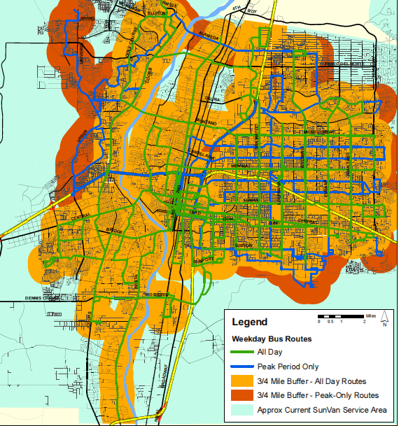

Slide 8
Response Time
Reservations available daily 8:00 am to 5:00 pm
Call throughput generally very good
  40 calls, on hold twice (called 8-10:00 AM daily)
  Calls generally answered in 4 rings
Negotiation all within +/- 1 hour requirement
  41% of calls accepted at time requested
  41% were within 30 minutes
  12% 31-45 minutes
  5% 46-60 minutes
Allowed too many reservations per call

Slide 9
Fares
$2.00 paratransit fare is twice the $1.00 bus fare, as per regulations
Coupon books provide a discount, which is not required

Slide 10
Trip Purpose
No prioritization by trip purpose, as per regulations

Slide 11
Hours and Days of Service
General 5:30 AM to 10:00 PM blanket coverage time is more generous than the bus system’s schedules
  Should be based on when bus service in an area is operating

Slide 12
Capacity Constraints
No Waiting lists
  “awaiting placement” is OK but should be watched
On-Time was Ok but could improve
  +/- 15 Minutes: 78%
  16-20 Minutes: 14%
  21-30 Minutes: 5%
No denials
One missed trip (2%)
  Dispatcher was unprofessional

Slide 13
Capacity Constraints cont.
Trip Duration reasonable
  66% <20 minutes
  22% were 21-30 minutes
  10% were >30 minutes, but were long trips (Coors to Eubank, etc.)
  If anything, many rides were direct and seemed to short to be efficient

Slide 14
Non-ADA Items
Few problems finding passengers (12%), none missed
No boarding delays
Few cases of drivers failing to assist passengers (3%)
No lift or other bus problems, all buses clean
Drivers failed to ensure seatbelts worn 70% of time
Securements always used, though improperly 7%
3 cases of drivers having difficulty with lap/shoulder belts
Driver attitude : 70% friendly, 30% Neutral, 0% hostile

Slide 15
Conclusions
No ADA compliance violations
Very good service overall
On time performance should be improved
Eligibility process should be redesigned and enhanced
  Better assessment of passenger needs
  Less reliance on medical verification
  More education of other transit options

Slide 16
Questions?

